Slide 1
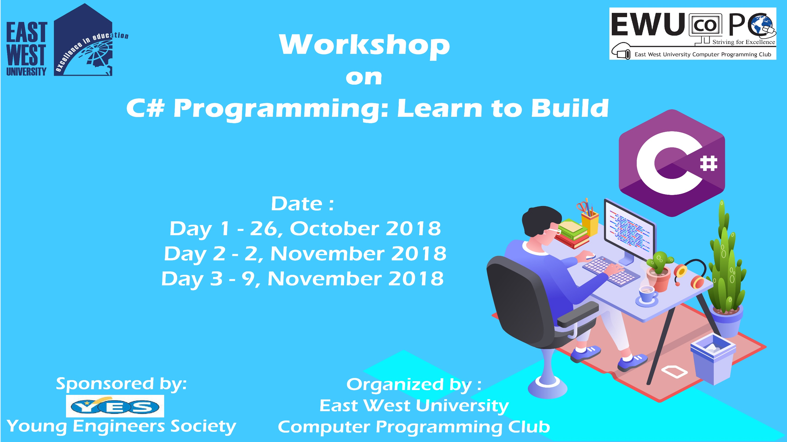

Slide 2
C# Day 1 Lecture2: Variable

Slide 3
Variable Declaration
<data type> <variable name>;

Slide 4
Variable Declaration
int number;
float num;
char alp;
bool value;
string text;

Slide 5
Variable Initialization
<data type> <variable name> = <value> ;

Slide 6
Variable Initialization
int number = 10;
Console.WriteLine(number);
Console.ReadKey();

Slide 7
Variable Initialization
float num = 10.06f;
Console.WriteLine(num);
Console.ReadKey();

Slide 8
Variable Initialization
char alp = 'A';
Console.WriteLine(alp);
Console.ReadKey();

Slide 9
Variable Initialization
bool value = true;
Console.WriteLine(value);
Console.ReadKey();

Slide 10
Variable Initialization
string text = "Hello Universe!";
Console.WriteLine(text);
Console.ReadKey();

Slide 11
Variable
int i = 100;
int j = i;
Console.WriteLine(j);
Console.ReadKey();
What will be the output?

Slide 12
Variable
int i;
int j = i;
Console.WriteLine(j);
Console.ReadKey();
What will be the output?

Slide 13
This slide is provided as a course material in the workshop named “Workshop on C# Programming: Learn to Build”.
Organized by-
East West University Computer Programming Club (EWUCoPC)
Prepared by- Jannat Binta Alam
Campus Ambassador
Young Engineers Society (YES)
E-mail: jannat.cse.ewu@gmail.com

